Slide 1
GenAI Course · Technion · 2026
ML PROJECT
Telecom Customer Churn Prediction
Predicting customer churn using three machine learning algorithms
Decision Tree
Random Forest
KNN
Idan Arbel · 204344022
|
Yovel Yefet · 318987815
April 2026
1 / 14

Slide 2
PROBLEM DEFINITION
What Are We Predicting & Why?
What We Predict
Available Data
Business Motivation
Whether a telecom customer will CHURN (cancel subscription) - a binary Yes / No classification task.
7,043 customer records with 21 features: demographics, services, contract details, and billing.
Acquiring a new customer costs 5–10x more than retaining one. Early detection enables proactive retention incentives.
Key Input Features: Contract Type · Tenure · Monthly Charges · Internet Service · Payment Method · Senior Citizen · Partner/Dependents + 14 more
2 / 14

Slide 3
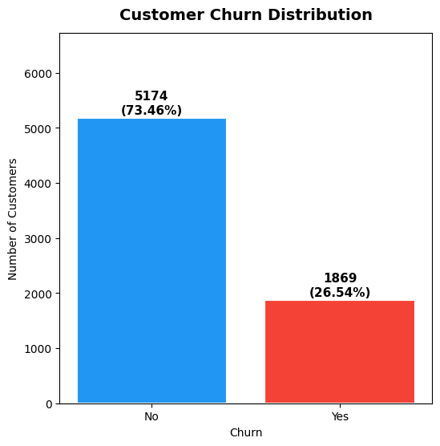
DATASET OVERVIEW
Scale, Structure & Label Distribution
7,043
21
73.5%
26.5%
Customer Records
Raw Features
Retained
Churned
Class Imbalance: 73.5% vs 26.5% - stratified split preserves ratio in train/test.
Hidden Nulls: 11 whitespace entries in TotalCharges - imputed with MonthlyCharges.
Train / Test: 80% / 20% stratified · Post-engineering shape: (7043, 28)
3 / 14

Slide 4
EXPLORATORY DATA ANALYSIS
Six Key Insights from the Data
CLASS IMBALANCE
CONTRACT TYPE
TENURE EFFECT
26.5%
43%
Declines
of customers churn - stratified sampling essential to preserve class ratio
Churn rate for month-to-month vs 11% yearly, 3% two-year. Strong Predictor.
New customers (<12 months) at highest risk.
Churn declines significantly with tenure.
Strong Predictor.
SENIOR CITIZENS
INTERNET SERVICE
MONTHLY CHARGES
42%
42%
Increases
churn rate vs 24% for non-seniors.
High-risk segment requires special attention
Fiber Optic vs 19% DSL and 7% no internet.
Higher charges correlate strongly with churn
4 / 14

Slide 5
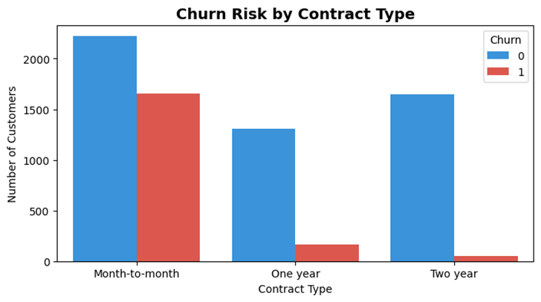
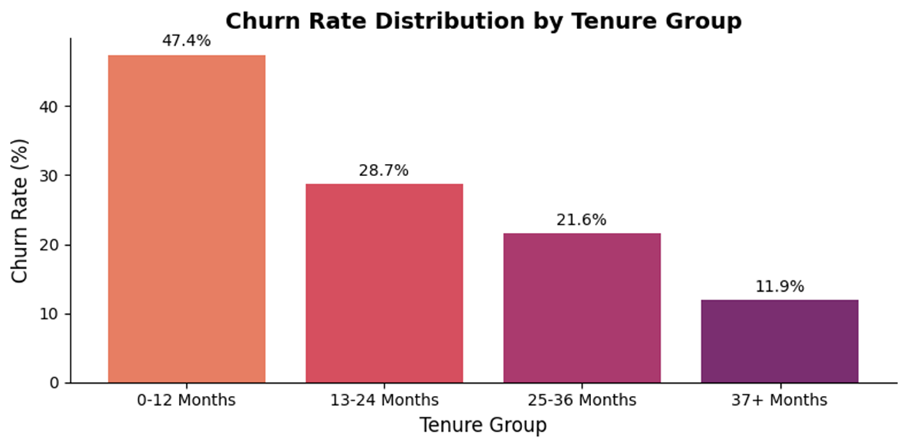
EDA DEEP DIVE
Churn Rate by Contract & Tenure Group
Month-to-month customers have ~15x higher churn than two-year holders. Long-term commitment strongly reduces switching risk.
First-year customers are the highest-risk segment. After 4+ years loyalty is deeply established and churn drops sharply.
5 / 14

Slide 6
DATA ENGINEERING
Transforming Raw Data into ML-Ready Features
Step | Transformation | Impact
Drop customerID | Unique per row - zero predictive signal | −1 column
Drop gender | Identical ~26% churn rate for M/F - no predictive signal | −1 column
Fix Hidden Nulls | TotalCharges whitespace → NaN → imputed with MonthlyCharges | 11 rows fixed
Encode Binary | Yes/No → 1/0: Partner, Dependents, PhoneService, PaperlessBilling | 4 columns
Engineer Features | services_count (0-7) and TenureGroup (0-3) created | + 2 new cols (next slide)
One-Hot Encode | InternetService, Contract, PaymentMethod, TenureGroup | + 14 dummy cols ( -4 attributes)
Drop Tenure | Replaced by TenureGroup | −1 column
21 → 29
(7043, 30)
Raw Features Final Features
Final Dataset Shape (features + label)
6 / 14

Slide 7
FEATURE ENGINEERING
Two New Features Created
services_count
TenureGroup
Range: 0 - 7
4 Bins: 0 - 3
Sum of 7 binary service columns: MultipleLines, OnlineSecurity, OnlineBackup, DeviceProtection, TechSupport, StreamingTV, StreamingMovies Why: EDA showed customers with more services have higher switching cost and churn less. One numeric feature replaces 7 columns.
Groups tenure into 4 bands matching EDA findings: 0 = 0-12 months | 1 = 13-24 months 2 = 25-48 months | 3 = 49+ months Why: Each band shows a distinct churn rate in EDA. bins=[-1, 12, 24, 48, 72] ensures tenure=0 falls in group 0.
services_count = sum(7 binary service columns)
pd.cut(tenure, bins=[-1,12,24,48,72], labels=[0,1,2,3]).astype(float)
7 / 14

Slide 8
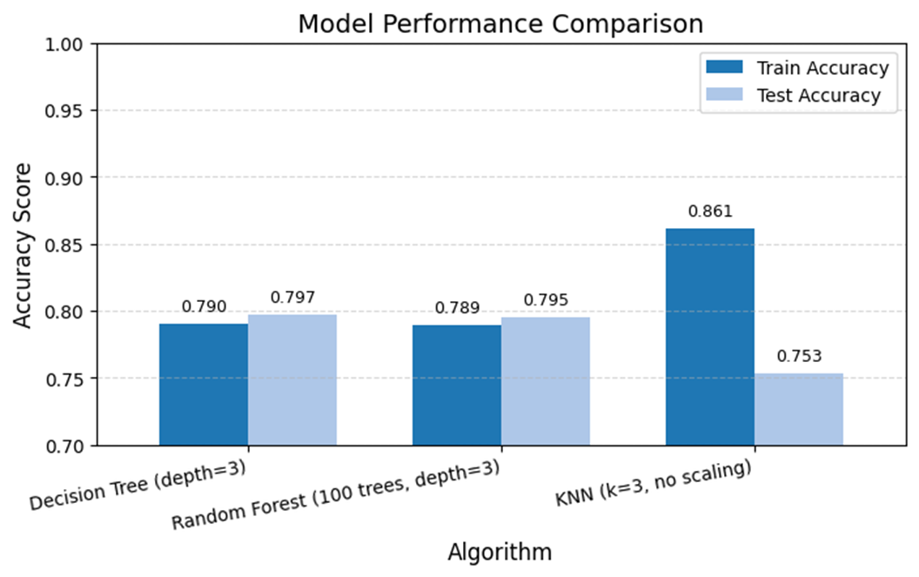
MACHINE LEARNING MODELS
Three Algorithms - Baseline Comparison
DECISION TREE
RANDOM FOREST
KNN
depth=3
100 trees, depth=3
k=3, unscaled
79.7%
79.5%
75.3%
Test Accuracy
Test Accuracy
Test Accuracy
Train: 78.99%
Train: 78.92%
Train: 86.1% (overfit)
Key Observation: KNN shows high train accuracy (86.1%) but weak generalization (75.3% test) - classic overfitting. DT and RF perform similarly at baseline (both use depth=3).
8 / 14

Slide 9
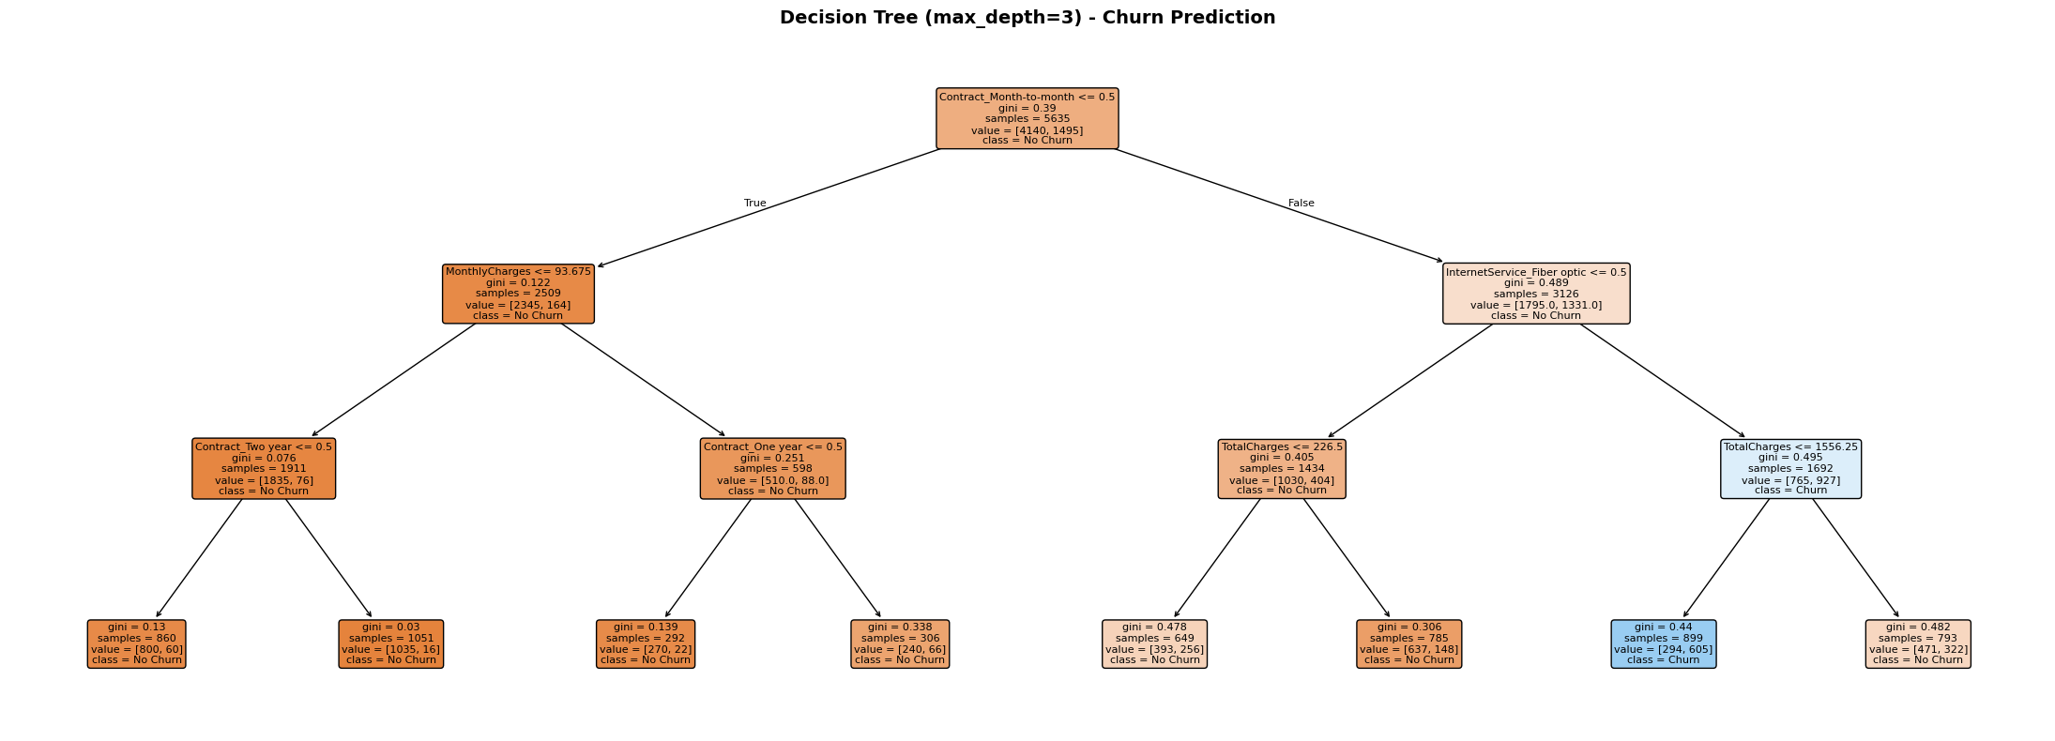
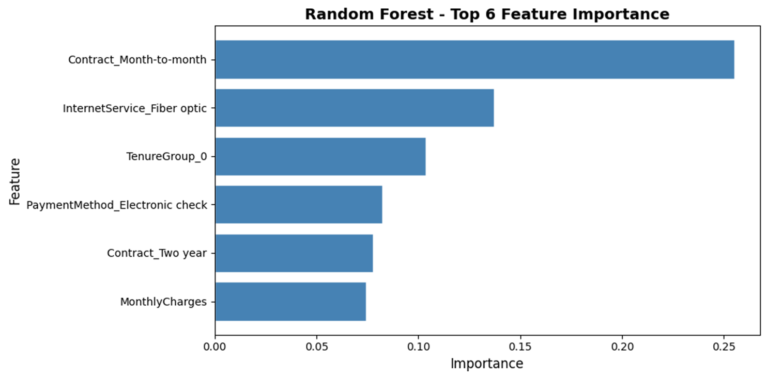
ALGORITHM INTROSPECTION
Decision Tree Rules & RF Feature Importance
Decision Tree - Key Learned Rules (depth=3)
Root Split: Contract_Month_to_month <= 0.5
-> Long-term contract path: Low churn (loyalty)
-> Month-to-month path: Split on tenure / TotalCharges
High-risk profile:
Month-to-month + Short tenure + High charges
At depth=3, rules are fully interpretable - business
teams can act on them without a data scientist.
10 / 14

Slide 10
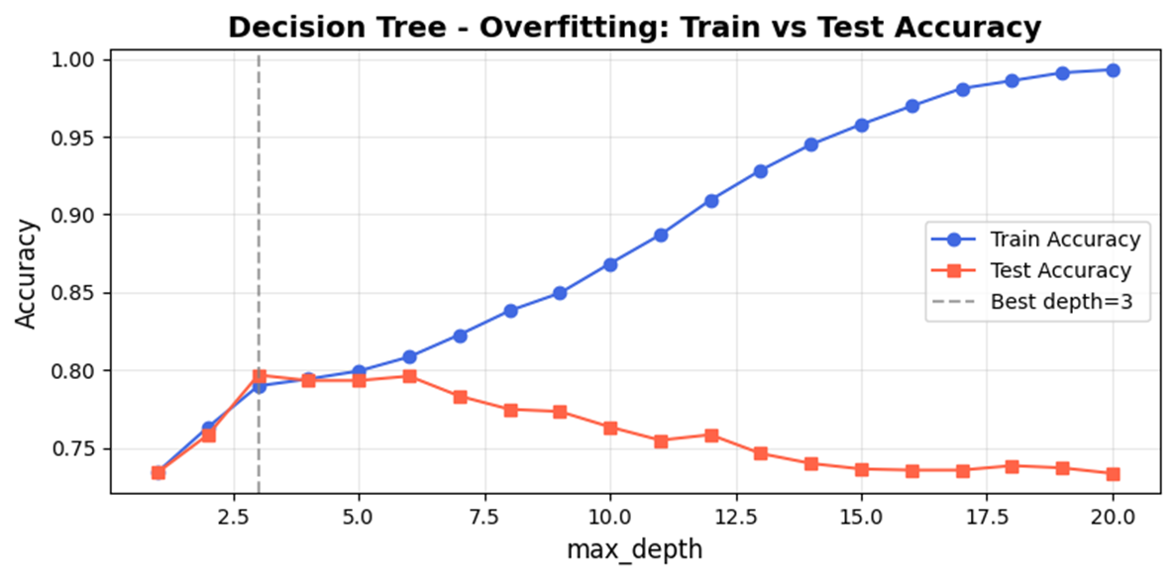
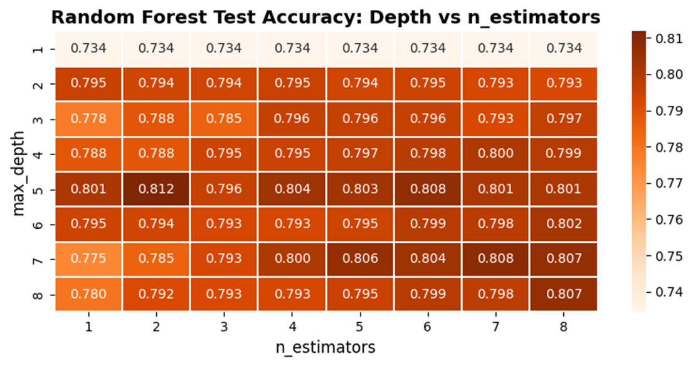
OVERFITTING ANALYSIS
Train vs Test - Hyperparameter Sweeps
Best Depth:
3
79.7% test
Best Config:
depth=5, n=2
81.2% test
9 / 14

Slide 11
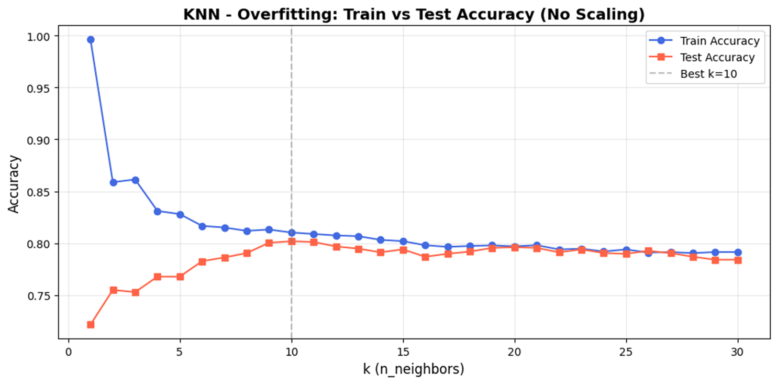
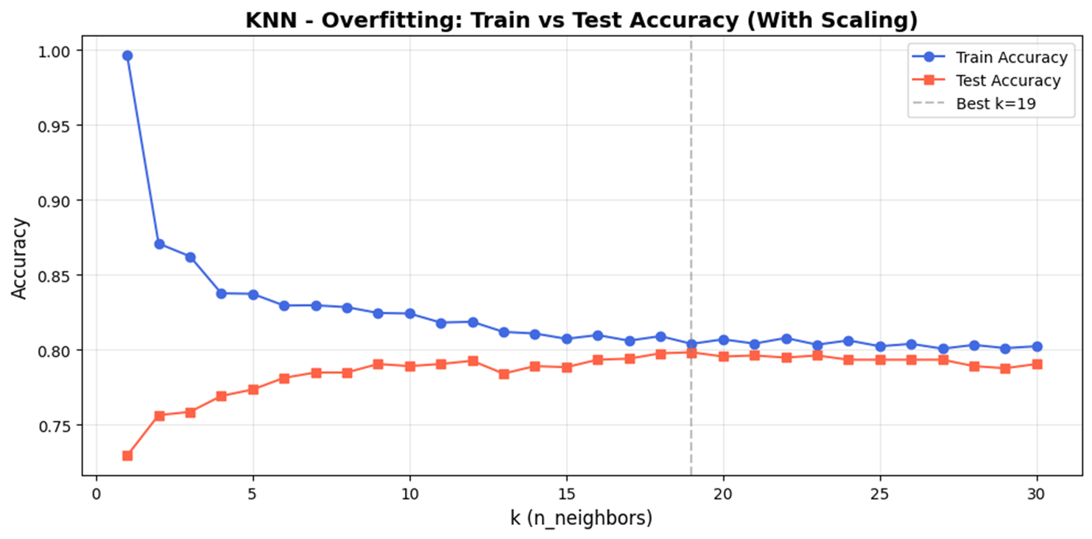
OVERFITTING ANALYSIS
Train vs Test - Hyperparameter Sweeps
Best K - No Scale:
K = 10
80.2% test
Best K - Scaled:
K = 19
79.8% test
9 / 14

Slide 12
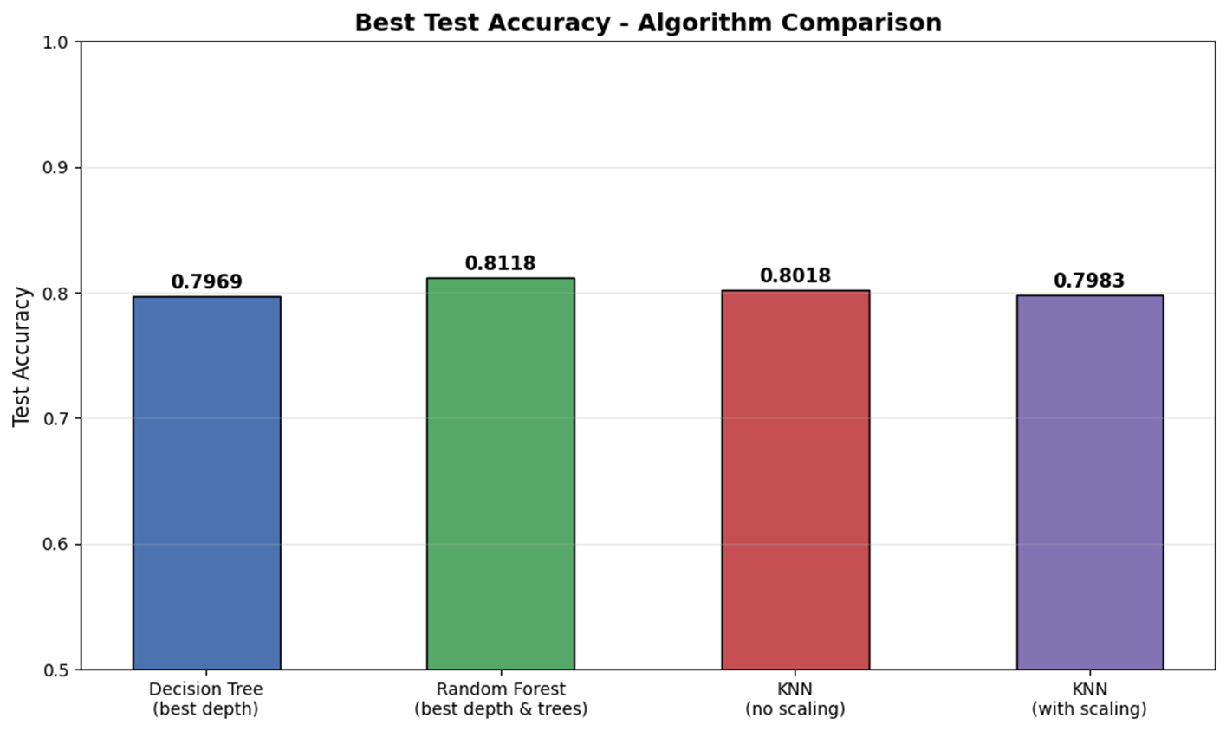
RESULTS
Best Accuracy - All Algorithms Compared
Algorithm | Best Configuration | Test Acc. | Verdict
Decision Tree | max_depth=3 | 79.7% | Stable
Random Forest | depth=5, n_estimators=2 | 81.2% | Best Overall
KNN (unscaled) | k=10 | 80.2% | Competitive
KNN + StandardScaler | k=19, scaled | 79.8% | Consistent
Insight: RF ensemble averaging reduces variance and captures non-linear feature interactions. KNN without scaling slightly outperforms scaled KNN - scaling changes distance geometry.
11 / 14

Slide 13
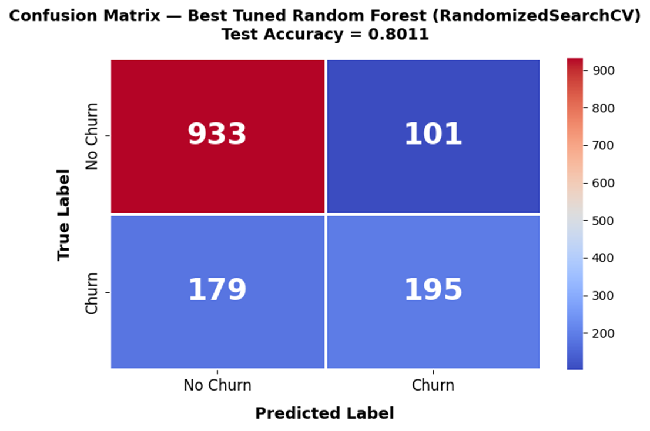
HYPERPARAMETER TUNING
GridSearchCV & Confusion Matrix
GridSearchCV - Random Forest
Search Space: n_estimators [50, 100, 200] x max_depth [None, 5, 10, 20]
Cross-Validation: 5-fold CV, scoring=accuracy
GridSearchCV
RandomizedSearchCV
80.0%
80.1%
depth=10, n=100
depth=10, n=200
Best Model: RandomizedSearchCV RF (max_depth=10, n=200) - 80.11% test accuracy. Tuning improved RF by ~1% vs the baseline configuration.
179 missed churns (FN) = most costly. Retention budget should target high-probability churn predictions to minimize false negatives.
12 / 14

Slide 14
BUSINESS & TECHNICAL INSIGHTS
Turning Predictions into Action
Top Churn Drivers (Confirmed by Model)
Final Algorithm Summary
#1
Contract Type
Model | Best Acc. | Verdict
Decision Tree | 79.7% | Interpretable
Random Forest | 81.2% | Best Overall
KNN (unscaled) | 80.2% | Competitive
RF (GridSearchCV) | 80.1% | Tuned
Month-to-month customers are 15x more likely to churn. Incentivise upgrades to annual contracts early in the relationship.
#2
Customer Tenure
New customers (<12 months) are at highest risk. Onboarding loyalty programmes dramatically reduce early churn.
Conclusion: Churn follows rule-based patterns - tree models outperform KNN. Random Forest is recommended: ensemble averaging reduces variance and captures complex feature interactions between contract, tenure, and charges.
#3
Monthly Charges
High-charge Fiber Optic users need targeted value messaging and bundled discounts before they look elsewhere.
13 / 14

Slide 15
Technion | GenAI Course | 2026
Thank You
Telecom Customer Churn Prediction
Idan Arbel
Yovel Yefet
204344022
318987815
Random Forest - 81.2% best accuracy
7,043 customers analysed
3 ML algorithms

